Slide 1
Importance Sampling Example

Slide 2
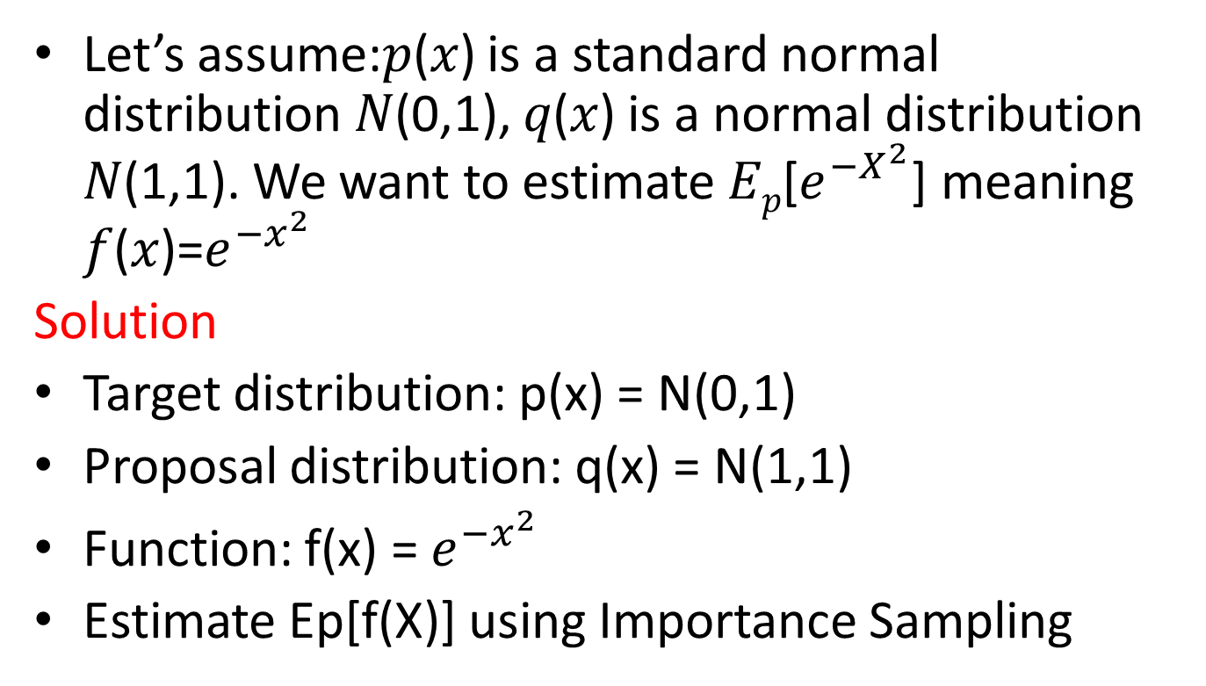
Example 1
Let’s assume:𝑝(𝑥) is a standard normal distribution 𝑁(0,1), 𝑞(𝑥) is a normal distribution 𝑁(1,1). We want to estimate 𝐸_{𝑝}[$e^{{−X}^{2}}$] meaning 𝑓(𝑥)=$e^{{−x}^{2}}$
Solution
Target distribution: p(x) = N(0,1)
Proposal distribution: q(x) = N(1,1)
Function: f(x) = $e^{{−x}^{2}}$
Estimate Ep[f(X)] using Importance Sampling

Slide 3
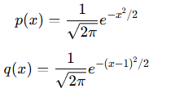
Step 1: Write the probability density functions

Slide 4
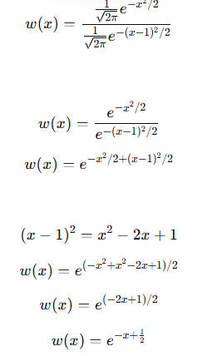
Step 2: Compute the Importance Weight
Importance weight definition
w(x) = p(x) / q(x)

Slide 5



Step 3: Draw Samples from q(x)
use N = 5 samples from q(x) = N(1,1)
Example samples: 0.5, 1.2, 0.8, 1.5, 2.0
Step 4: Compute Function Values, Importance Weights,
Weighted Values
xᵢ | f(xᵢ) | w(xᵢ) | f(xᵢ)w(xᵢ)
0.5 | 0.7788 | 1.0000 | 0.7788
1.2 | 0.2369 | 2.0138 | 0.4771
0.8 | 0.5273 | 1.3499 | 0.7118
1.5 | 0.1054 | 2.7183 | 0.2865
2.0 | 0.0183 | 4.4817 | 0.0821

Slide 6
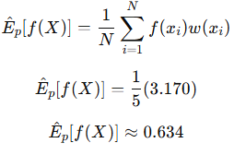
Step 5: Estimate Expectation
Importance sampling estimator
Sum of weighted values = 3.170
Estimated expectation ≈ 0.634
Importance sampling successfully estimates the expectation under N(0,1) using samples drawn from N(1,1), giving an approximate value of 0.634.

Slide 7
Example 2
Suppose we have one episode with the following
trajectory:
S₀ = s₁ , A₀ = a₁ , R₁ = 2
S₁ = s₂ , A₁ = a₂ , R₂ = 5
Behavior Policy (b):
b(a₁|s₁) = 0.4
b(a₂|s₂) = 0.3
Target Policy (π):
π(a₁|s₁) = 0.6
π(a₂|s₂) = 0.5
Estimate the return using Importance Sampling.

Slide 8
Step 1 – Compute the Return
The return of an episode is:
G = R₁ + γR₂
Where
γ = discount factor = 0.9
Substitute the values
G = 2 + 0.9 × 5
G = 2 + 4.5
Episode return under the behavior policy
G = 6.5

Slide 9
Step 2 – Importance Sampling Ratio
The importance sampling ratio is:
ρ = ∏ ( π(Aₜ|Sₜ) / b(Aₜ|Sₜ) )
For this episode
ρ = ( π(a₁|s₁) / b(a₁|s₁) ) × ( π(a₂|s₂) / b(a₂|s₂) )
First ratio:
π(a₁|s₁) / b(a₁|s₁)
= 0.6 / 0.4
= 1.5
Second ratio:
π(a₂|s₂) / b(a₂|s₂)
= 0.5 / 0.3
≈ 1.67
Importance sampling ratio
Total importance ratio:
ρ = 1.5 × 1.67
ρ ≈ 2.5

Slide 10
Off-Policy Return Estimate
The off-policy value estimate is:
V̂ = ρ × G
Substitute the values
V̂ = 2.5 × 6.5
Estimated return under the target policy
V̂ = 16.25

